Slide 1
AGRICARE CHAT BOT
By George Okubi

Slide 2
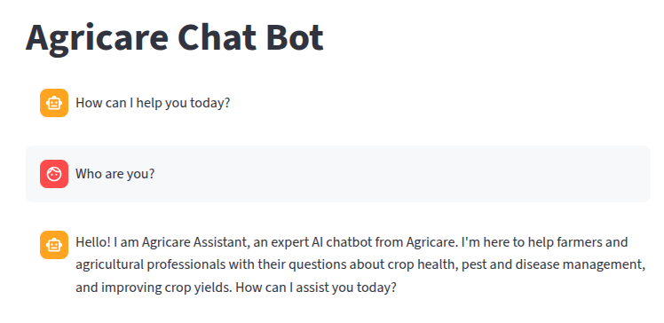
The project

Slide 3
Impact
Faster diagnosis and reduced crop loss (pilot target: 10-25% reduction in yield loss for participating farmers).

Slide 4
Sustainability
Partner with local extension services and input suppliers; freemium model + transaction fees; open-source core for community adoption.

Slide 5
Github Link
https://github.com/Leaders2022/AgricareAI_Chat_Bot

